Slide 1
XB6 Fan Detection
Base on Magnetic field detection
A new idea and proposal By Cable SW RD Team
Prepared by: Gavin
Update date: 2018/11/24

Slide 2
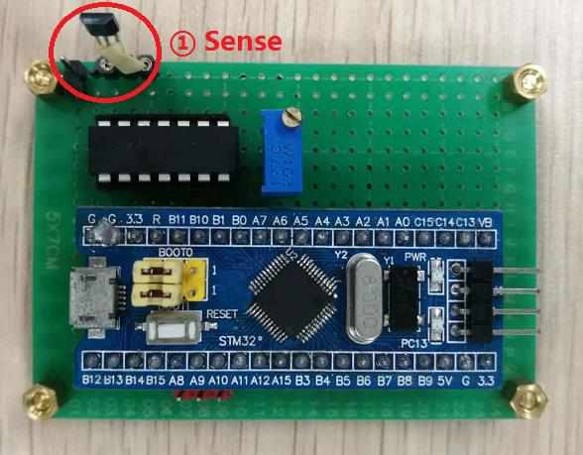
The Problem Background
XB6 after assembling the housing, it is very difficult to detect whether the fan is working normally
(it is difficult to detect by image, sound, vibration, etc.).
Idea and proposal
We designed a device to detect the weak magnetic field changes.
Real photo, as shown right:

Slide 3
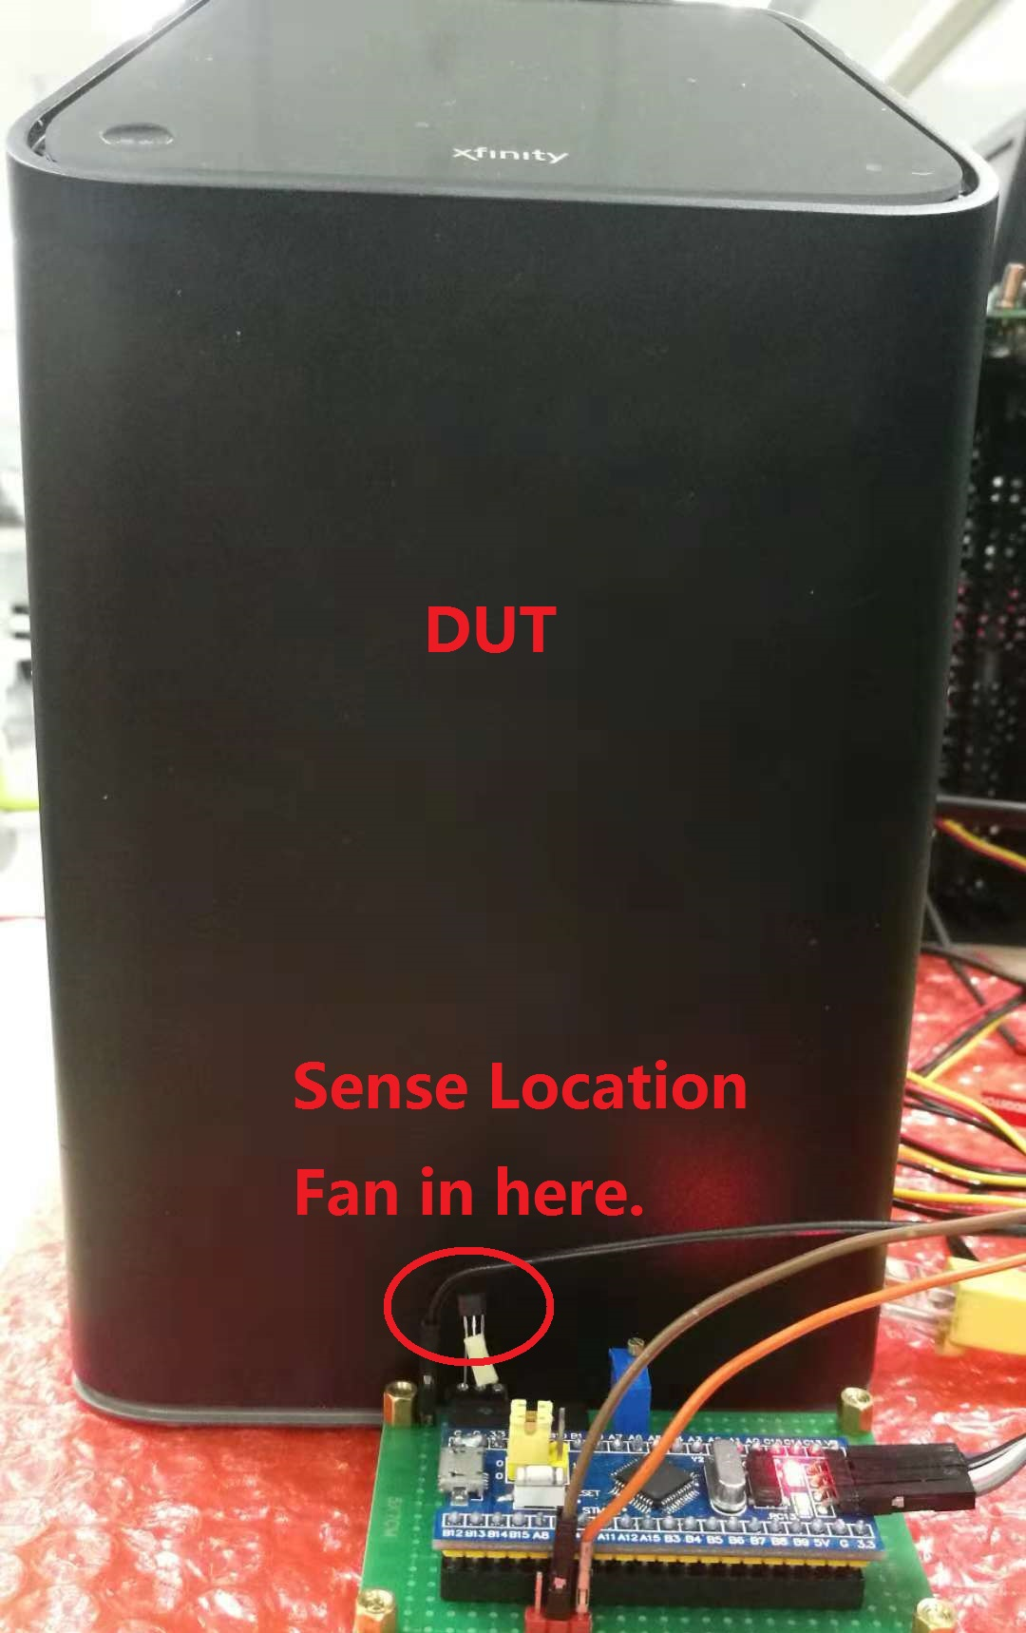
Test and Use Methods
Just place the sensor of this device close to the fan position of DUT,
as shown in the figure left

Slide 4
Test Results
If the fan works normally, the Green LED turns on; if it does not work, the Red LED flashes.
And the device can be connected to PC, using a virtual oscilloscope to display the test results
As shown in the figure below

Slide 5
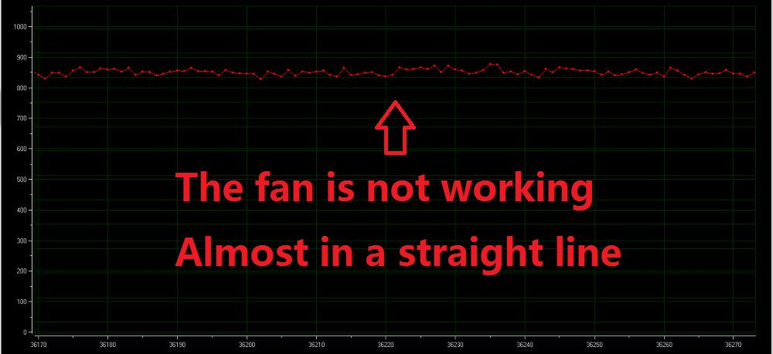
The fan does not work (virtual oscilloscope display )

Slide 6
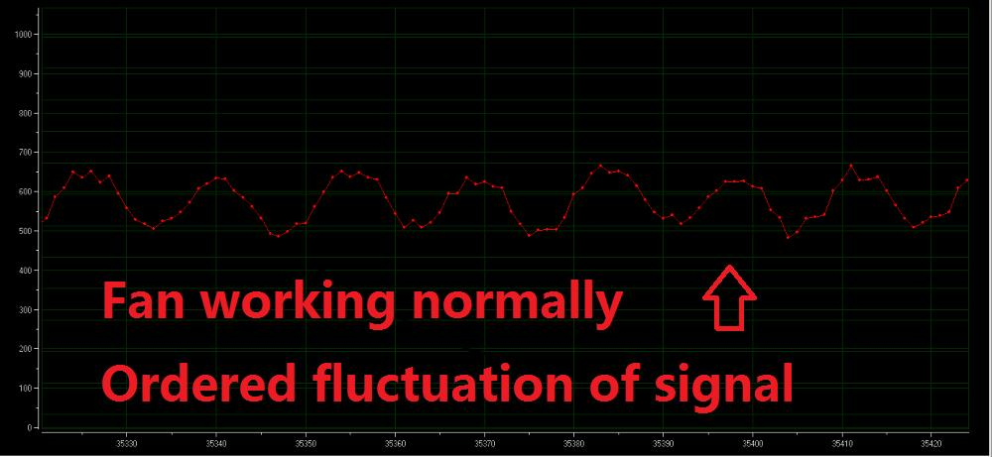
The fan works normally (virtual oscilloscope display )

Slide 7
About the design of this device
The cost of device：about 10 Yuan (￥ , RMB)
Detection Principle：
When the fan is at motionless, there is a static magnetic field around it.
Once it rotates, it will generate a continuously changing magnetic field.
We use this point, through a Hall-Effect Sensors signal acquisition and processing.

Slide 8
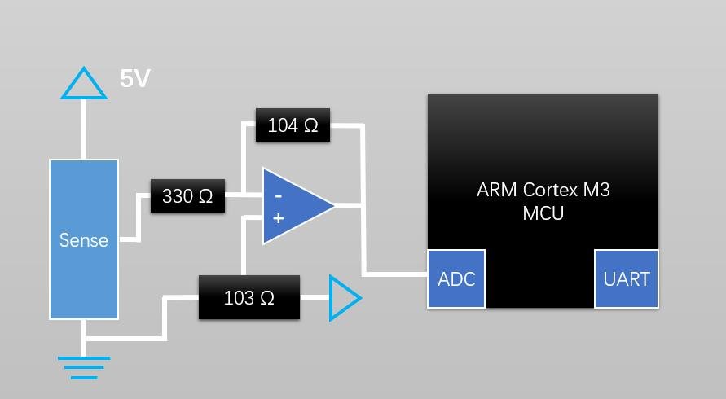
Hardware Design
Sense （signal） ==> Amplification gain circuit （About 250 times）==> Microprocessor

Slide 9
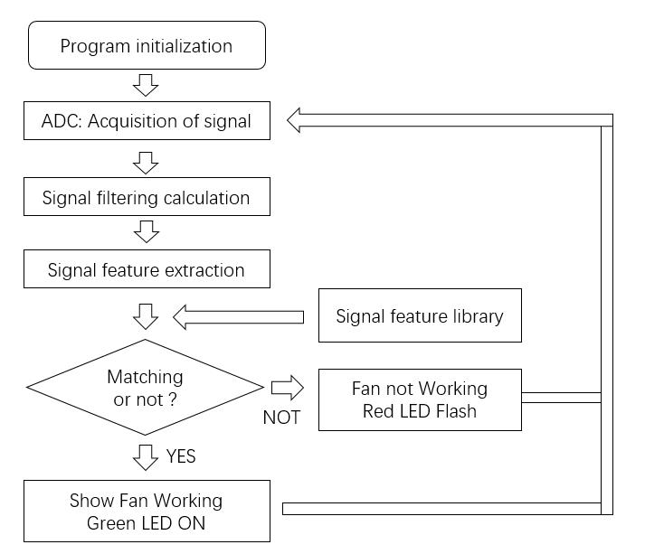
Software Design
We use signal feature matching algorithm processing to distinguish real fan magnetic field signals, which can effectively resist interference.
For example, the XB6 DUT built-in AC-DC power adapter generates magnetic field interference, as well as the surrounding environment of the factory.

Slide 10
Thanks For Guidance

